Slide 1
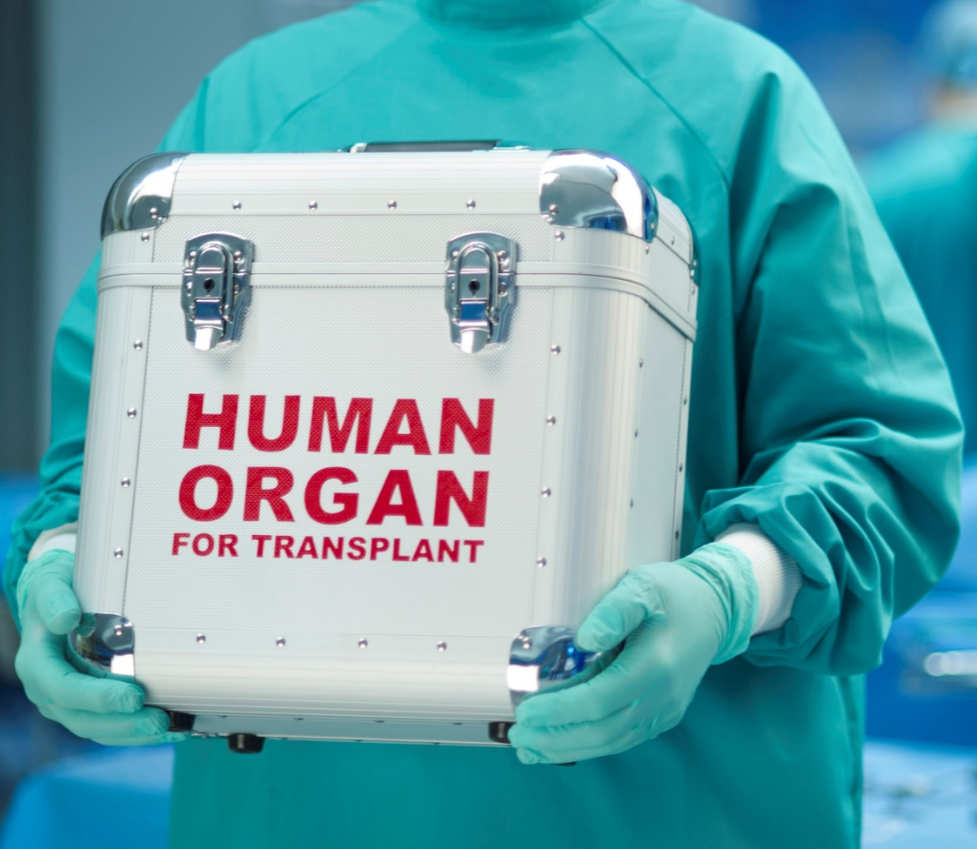
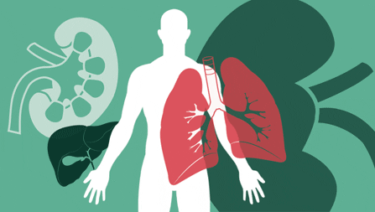
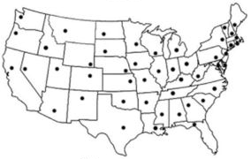
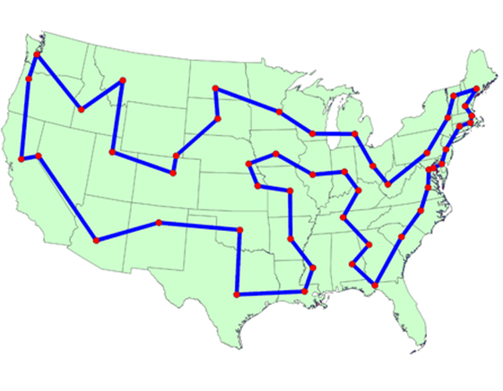
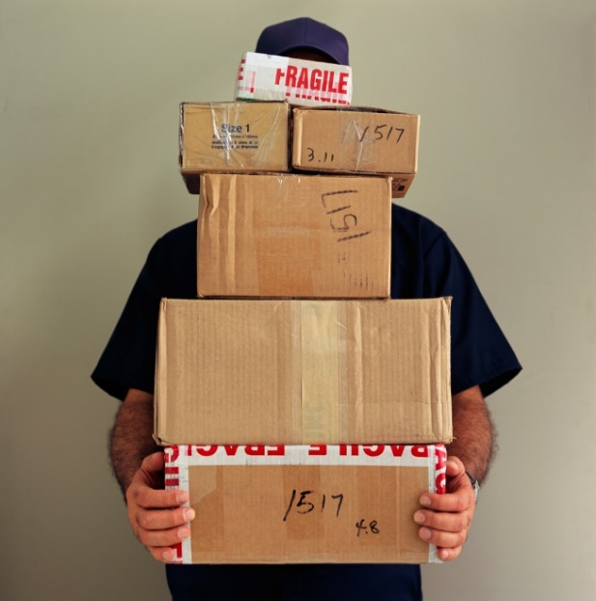
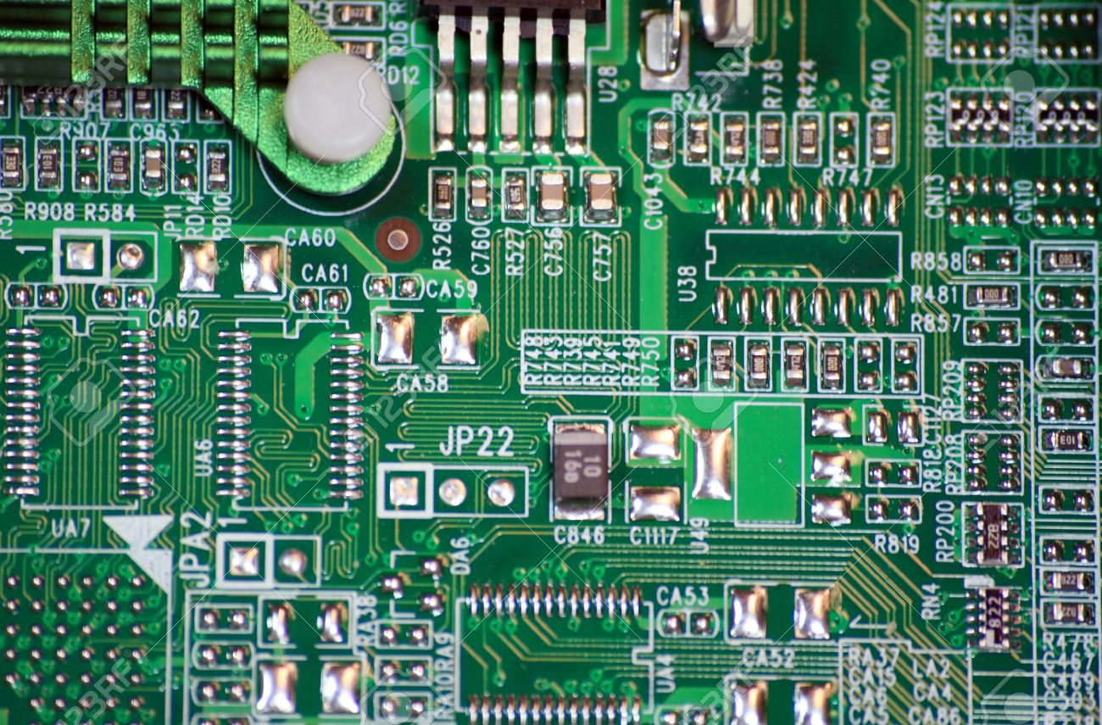
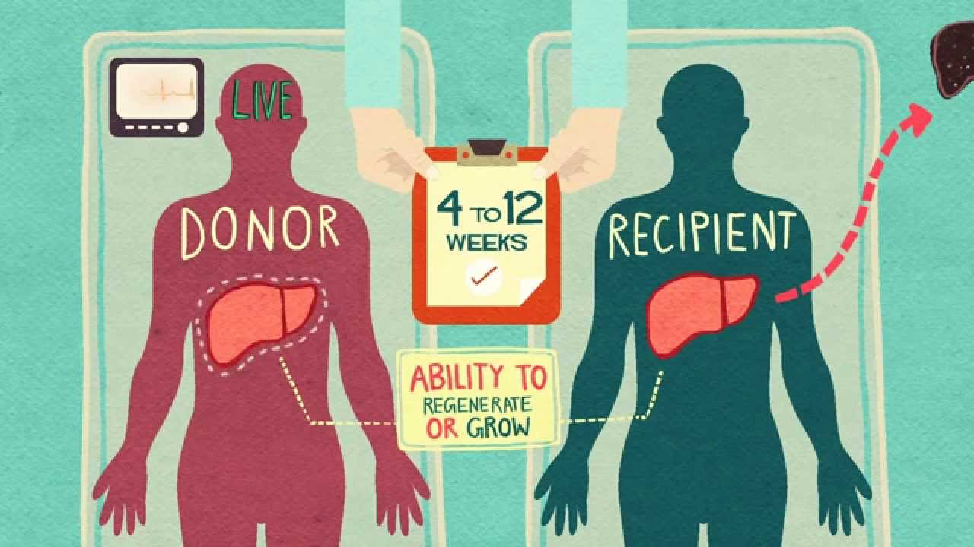
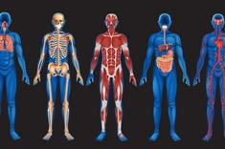
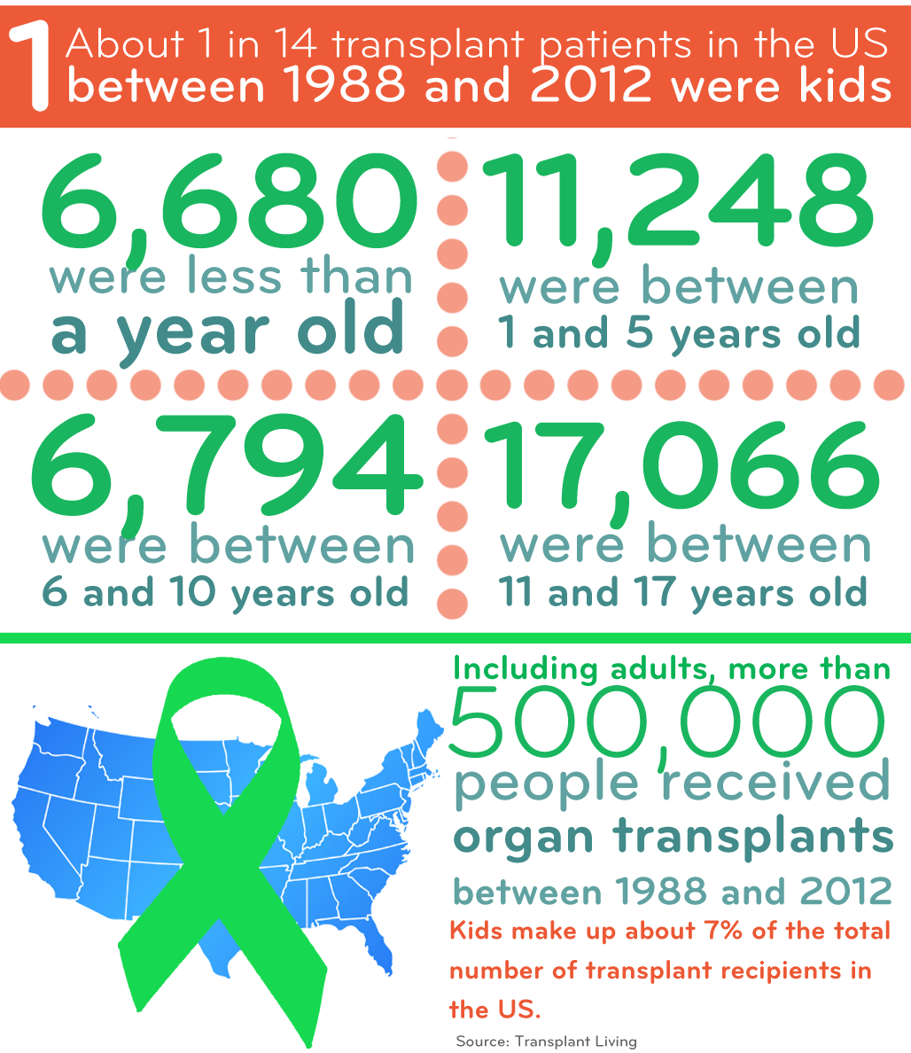
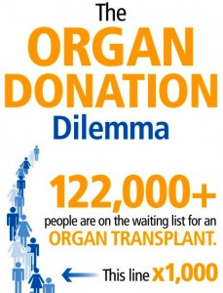
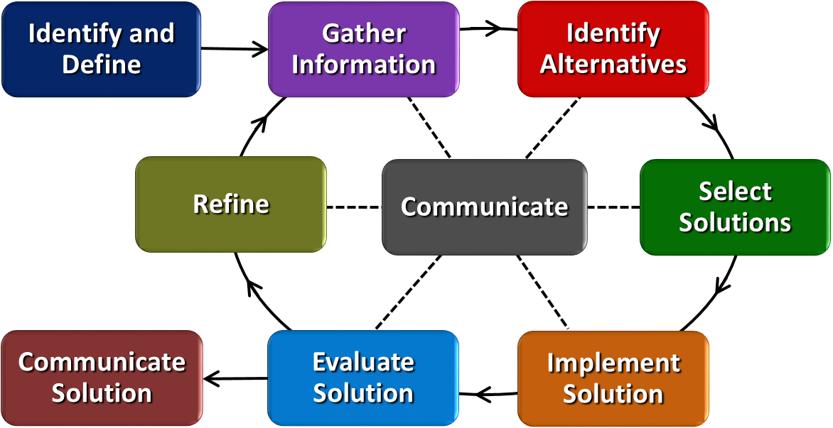
Optimizing Organ Donation Samy Lafin Scott High School - Biology
RET is funded by the National Science Foundation, grant # EEC-1404766
Summer Research
How can we use this?
Why is this important?
Traveling Salesman Problem (TSP)
Find the shortest route
Number of cities increases = number of solutions increases exponentially
Genetic Algorithms
Computer code that mimics natural evolutionary processes
Two-Opt
Compares distances between two options
Chooses the solution that has less distance
TSP Applications
School Buses
Postal/Delivery Routes
Computer Microchip Design
Biological Applications
Engineer Solutions to Biological Problems
Organ Donation
The Big Idea
Graphics: https://s-media-cache-ak0.pinimg.com/236x/9f/9e/da/9f9eda074c5ca22b20535260b61d50c5.jpg, https://support.sas.com/documentation/cdl/en/ornoaug/65289/HTML/default/images/map002g.png, http://www.tisimgames.com/genetic-algorithm-optimization-in-unity-3d/, http://assets.devx.com/articlefigs/18116.jpg, http://14ofbh43mhks2blp6o3lj28g.wpengine.netdna-cdn.com/wp-content/uploads/2014/01/school-bus.jpg, https://www.bbb.org/globalassets/shared/media/news-center-articles-images/mail/package_delivery.jpg, http://previews.123rf.com/images/btmedia/btmedia0903/btmedia090300027/4496568-Macro-View-of-Computer-Circuits-Motherboard-or-microchip-closeup--Stock-Photo.jpg, http://www.livescience.com/images/i/000/025/668/i235/human-body-systems.jpg?1332445752, https://s-media-cache-ak0.pinimg.com/236x/9f/9e/da/9f9eda074c5ca22b20535260b61d50c5.jpg, http://www.livingneworleans.com/wp-content/uploads/2012/04/donate-life.jpg, http://www.bioethics.com/wp-content/uploads/2014/03/organ-donation-transplantation.jpg, http://www.organdonationscotland.org/sites/default/files/types-of-donation.jpg, https://i.ytimg.com/vi/vSi9eHAFvGA/maxresdefault.jpg, http://smallbeats.childrensomaha.org/wp-content/uploads/2015/01/01.png, http://www.donorrecovery.org/wp-content/uploads/2011/10/Excellus-BlueCross-Blue-Shield-Organ-Donation-Infographic-229x300.jpg

